Slide 1
Lecture [11][1] Strings
Dr. Siming Liu

Slide 2
Midterm[1]
Low: 14, High: 98, Avg: 70.68

Slide 3
String idioms

Slide 4
Searching for the End of a String
A function strlen that searches for the end of a string, using a variable to keep track of the string’s length:
size_t strlen(const char *s)
{
size_t n;
for (n = 0; *s != '\0'; s++)
n++;
return n;
}
size_t is an unsigned integer type of at least 16 bits

Slide 5
Searching for the End of a String
To condense the function, we can move the initialization of n to its declaration:
size_t strlen(const char *s)
{
size_t n = 0;
for (; *s != '\0'; s++)
n++;
return n;
}
same as *s != 0
same as *s

Slide 6
Searching for the End of a String
A version of strlen that uses these observations:
size_t strlen(const char *s)
{
size_t n = 0;
for (; *s; s++)
n++;
return n;
}
`
increment s and tests *s in the same expression

Slide 7
Searching for the End of a String
Increments s and tests *s in the same expression:
size_t strlen(const char *s)
{
size_t n = 0;
for (; *s++;)
n++;
return n;
}
Replacing the for statement with a while statement
size_t strlen(const char *s)
{
size_t n = 0;
while (*s++)
n++;
return n;
}

Slide 8
Searching for the End of a String
Although we condensed strlen quite a bit, we have not increased its speed.
A faster version, at least with some compilers:
size_t strlen(const char *s)
{
const char *p = s;
while (*s)
s++;
return s - p;
}
Here we increment a pointer instead of a variable

Slide 9
Searching for the End of a String
Idioms for “search for the null character at the end of a string”:
while (*s)
s++;
while (*s++)
;
leaves s pointing to the null character.
more concise, but leaves s pointing just past the null character.

Slide 10
Concatenating two Strings
Problem:
Copy a string at the end of another string (concatenate strings)
Two-step algorithm:
Step 1: Locate the null character at the end of the string s1 and make p point to it.
Step 2: Copy characters one by one from s2 to where p is pointing.

Slide 11
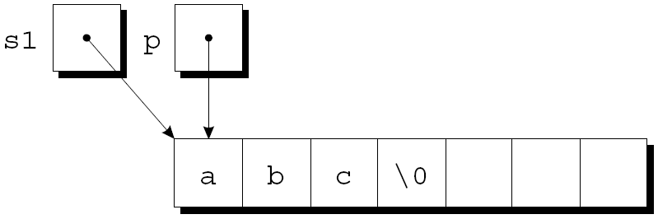
Concatenating two Strings – Step 1
p initially points to the first character in the s1 string:
char *strcat(char *s1, const char *s2)
{
char *p = s1;
…
return s1;
}

Slide 12
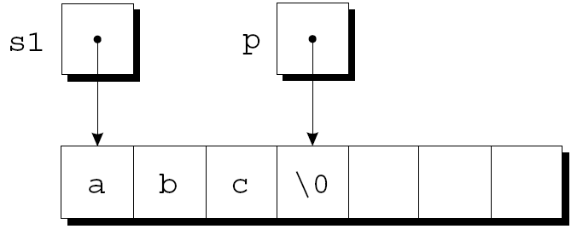
Concatenating two Strings – Step 1
Have a while statement locate the null character at the end of s1 and make p point to it:
char *strcat(char *s1, const char *s2)
{
char *p = s1;
while (*p != '\0')
p++;
…
return s1;
}

Slide 13
Concatenating two Strings – Step 2
Copy one character from where s2 points to where p points, increments both p and s2.
char *strcat(char *s1, const char *s2)
{
char *p = s1;
while (*p != '\0')
p++;
while (*s2 != '\0') {
*p = *s2;
p++;
s2++;
}
…
return s1;
}
The strings after the first loop iteration:

Slide 14
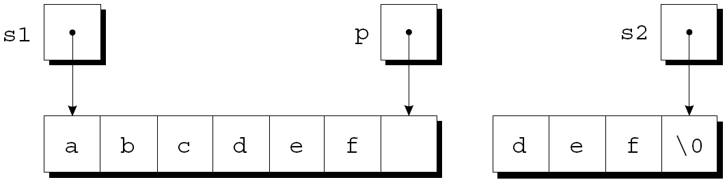
Concatenating two Strings – Step 2
The loop terminates when s2 points to the null character:
After putting a null character where p is pointing, strcat returns.

Slide 15
Concatenating two Strings
char *strcat(char *s1, const char *s2)
{
char *p = s1;
while (*p != '\0')
p++;
while (*s2 != '\0') {
*p = *s2;
p++;
s2++;
}
*p = '\0';
return s1;
}

Slide 16
Concatenating two Strings
Condensed version of strcat:
char *strcat(char *s1, const char *s2)
{
char *p = s1;
while (*p)
p++;
while (*p++ = *s2++)
;
return s1;
}

Slide 17
Copying a String
The heart of the streamlined strcat function is the “string copy” idiom:
while (*p++ = *s2++)
;
Ignoring the two ++ operators, the expression inside the parentheses is an assignment:
*p = *s2
After the assignment, p and s2 are incremented.
Repeatedly evaluating this expression copies characters from where s2 points to where p points.

Slide 18
Copying a String
But what causes the loop to terminate?
The while statement tests the character that was copied by the assignment *p = *s2.
All characters except the null character test true.
The loop terminates after the assignment, so the null character will be copied.

Slide 19
Arrays of strings

Slide 20
Arrays of Strings
Use a two-dimensional array of characters, with one string per row:
char planets[][8] = {"Mercury", "Venus", "Earth",
"Mars", "Jupiter", "Saturn",
"Uranus", "Neptune", "Pluto"};
The number of rows in the array can be omitted, but we must specify the number of columns.

Slide 21
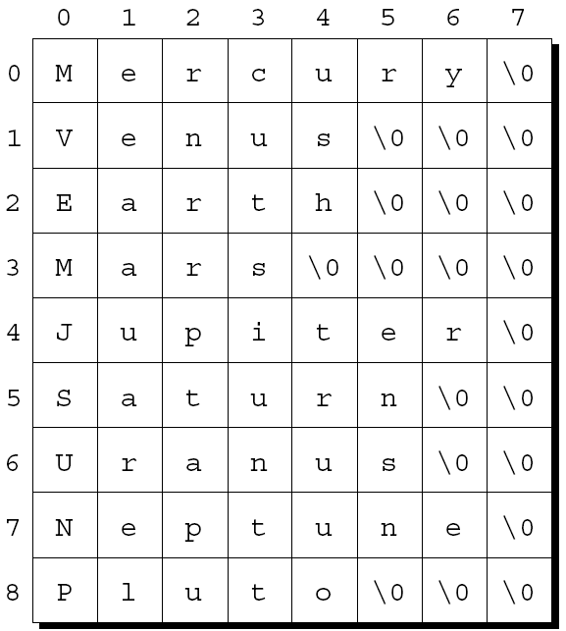
Arrays of Strings
Unfortunately, the planets array contains a fair bit of wasted space (extra null characters):

Slide 22
Arrays of Strings
Most collections of strings will have a mixture of long strings and short strings.
What we need is a ragged array, whose rows can have different lengths.
We can simulate a ragged array in C by creating an array whose elements are pointers to strings:
char *planets[] = {"Mercury", "Venus", "Earth",
"Mars", "Jupiter", "Saturn",
"Uranus", "Neptune", "Pluto"};

Slide 23
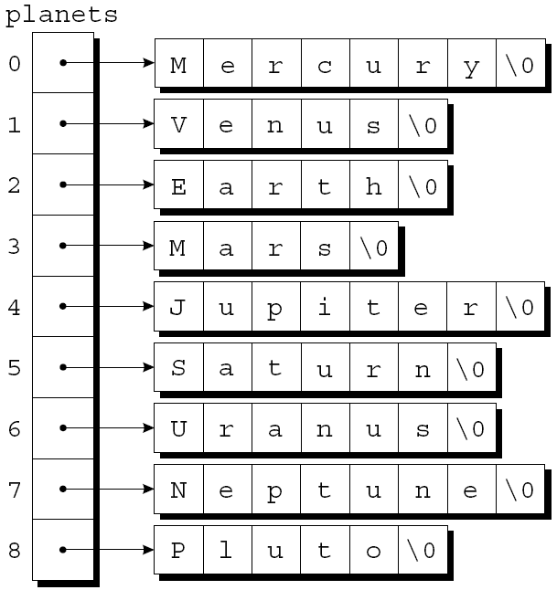
Arrays of Strings
Here is how the new planets is stored:

Slide 24
Accessing Elements in Arrays of Strings
To access one of the planet names, all we need do is subscript the planets array.
Same as accessing an element of a two-dimensional array.
Searches the planets array for strings beginning with the letter M:
for (i = 0; i < 9; i++)
if (planets[i][0] == 'M')
printf("%s begins with M\n", planets[i]);

Slide 25
Command-line arguments

Slide 26
Command-Line Arguments
When we run a program, we often need to supply it with information.
This may include a file name or a switch that modifies the program’s behavior.
Examples of the UNIX ls command:
ls
ls –l
ls -l remind.c

Slide 27
Command-Line Arguments
Command-line information is available to all programs, not just operating system commands.
To obtain access to command-line arguments, main must have two parameters:
int main(int argc, char *argv[])
{
…
}
Command-line arguments are called program parameters in the C standard.

Slide 28
int main(int argc, char *argv[]){…}
argc: argument count, is the number of command-line arguments.
argv: argument vector, is an array of pointers to the command-line arguments (stored as strings).
argv[0] points to the name of the program
argv[1] through argv[argc-1] point to the remaining command-line arguments.
argv[argc]is always a null pointer—a special pointer that points to nothing.
The macro NULL represents a null pointer.

Slide 29
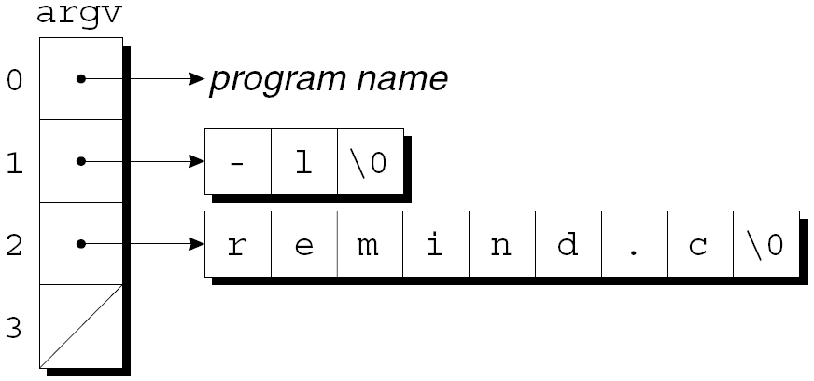
Command-Line Arguments
If the user enters the command line
ls -l remind.c
then argc will be 3, and argv will have the following appearance:

Slide 30
Accessing Command-Line Arguments
Use a loop that examines each argument in the argv array:
int i;
for (i = 1; i < argc; i++)
printf("%s\n", argv[i]);

Slide 31
Accessing Command-Line Arguments
Another technique: set up a pointer to argv[1], then increment the pointer repeatedly:
char **p;
for (p = &argv[1]; *p != NULL; p++)
printf("%s\n", *p);

Slide 32
Program: Checking Planet Names
The planet.c program checks a series of strings to see which ones are names of planets.
planet Jupiter venus Earth fred
The program will indicate whether each string is a planet name and, if it is, display the planet’s number:
Jupiter is planet 5
venus is not a planet
Earth is planet 3
fred is not a planet

Slide 33
planet.c
#include <stdio.h>
#include <string.h>
#define NUM_PLANETS 9
int main(int argc, char *argv[])
{
char *planets[] = {"Mercury", "Venus", "Earth",
"Mars", "Jupiter", "Saturn",
"Uranus", "Neptune", "Pluto"};
int i, j;

Slide 34
planet.c
for (i = 1; i < argc; i++) {
for (j = 0; j < NUM_PLANETS; j++)
if (strcmp(argv[i], planets[j]) == 0) {
printf("%s is planet %d\n", argv[i], j + 1);
break;
}
if (j == NUM_PLANETS)
printf("%s is not a planet\n", argv[i]);
}
return 0;
}
C string library function: returns 0 if the strings are identical

Slide 35
C string library

Slide 36
Using the C String Library
Some programming languages provide operators that can copy strings, compare strings, concatenate strings, select substrings.
In C, strings are treated as arrays, so they are restricted in the same ways as arrays.
Strings cannot be copied or compared using operators.

Slide 37

Using the C String Library
Direct attempts to copy (using =) or compare strings (using ==) are not possible:
char str1[10], str2[10];
…
str1 = "abc"; /*** WRONG ***/
str2 = str1; /*** WRONG ***/
Using an array name as the left operand of = is illegal.
Initializing a character array using = is legal:
char str1[10] = "abc";
= is not the assignment operator, but acts as initializer

Slide 38
Using the C String Library
Attempting to compare strings using a relational or equality operator is legal but won’t produce the desired result:
if (str1 == str2) … /*** WRONG ***/
compares str1 and str2 as pointers.
Since str1 and str2 have different addresses, the expression str1 == str2 will have the value 0.

Slide 39
Using the C String Library
The C library provides a rich set of functions for performing operations on strings.
Programs that need string operations should contain the following line:
#include <string.h>
In subsequent examples, assume that str1 and str2 are character arrays used as strings.

Slide 40
The strcpy (String Copy) Function
char *strcpy(char *s1, const char *s2);
Copies the string pointed to by s2 into the array pointed to by s1
Returns s1 (a pointer to the destination string).
strcpy(str2, "abcd");
/* str2 now contains "abcd" */
strcpy(str1, str2);
/* str1 now contains "abcd" */

Slide 41
The strcpy (String Copy) Function
In the call
strcpy(str1, str2);
strcpy has no way to check that the str2 string will fit in the array pointed to by str1.
If it does not, undefined behavior occurs.

Slide 42
The strncpy Function
Calling the strncpy function is a safer, albeit slower, way to copy a string.
A call of strncpy that copies str2 into str1:
strncpy(str1, str2, sizeof(str1));
strncpy has a third argument that limits the number of characters that will be copied.

Slide 43
Low-level programming: Bitwise operators

Slide 44
Bitwise Operators
Modify data at bit level
Operator | Name | Type
<< | Left shift | Unary
>> | Right shift | Unary
~ | Bitwise complement | Unary
& | Bitwise and | Binary
^ | Bitwise exclusive or | Binary
| | Bitwise (inclusive) or | Binary

Slide 45
Bitwise Shift Operators
The value of i << j is the result when the bits in i are shifted left by j places.
For each bit that is “shifted off” the left end of i, a zero bit enters at the right.
The value of i >> j is the result when i is shifted right by j places.
If i is of an unsigned type or if the value of i is nonnegative, zeros are added at the left as needed.
If i is negative, the result is implementation-defined.

Slide 46
Bitwise Shift Operators
unsigned short i = 13, j;
/* i is now 13 (binary 0000000000001101) */
j = i << 2;
/* j is now 52 (binary 0000000000110100) */
j = i >> 2;
/* j is now 3 (binary 0000000000000011) */
For each bit that is “shifted off” the left end of i, a zero bit enters at the right.
For each bit that is “shifted off” the right end of i, a zero bit enters at the left.

Slide 47
Compound Bitwise Shift Operators
To modify a variable by shifting its bits, use the compound assignment operators <<= and >>=:
i = 13;
/* i is now 13 (binary 0000000000001101) */
i <<= 2;
/* i is now 52 (binary 0000000000110100) */
i >>= 2;
/* i is now 13 (binary 0000000000001101) */

Slide 48
Precedence of Bitwise Shift Operators
The bitwise shift operators have lower precedence than the arithmetic operators:
i << 2 + 1
means:
i << (2 + 1)
not:
(i << 2) + 1

Slide 49
Bitwise Complement, And, Exclusive Or, and Inclusive Or
The ~, &, ^, and | operators perform Boolean operations on all bits in their operands.
The operands work bit by bit, on the corresponding bits of the operands
Operator | Name | Action
~ | Bitwise complement | Flips every bit: 0 to 1 and 1 to 0
& | Bitwise and | Produces 1 if both bits are 1
^ | Bitwise exclusive or | Produces 1 if both bits are different
| | Bitwise (inclusive) or | Produces 1 if at least one bit is 1

Slide 50
Bitwise Complement, And, Exclusive Or, and Inclusive Or
unsigned short i = 21, j = 56, k;
/* i is now 21 (binary 0000000000010101) */
/* j is now 56 (binary 0000000000111000) */
k = ~i;
k = i & j;
k = i ^ j;
k = i | j;
// k is now 65514 (binary 1111111111101010)
// k is now 16 (binary 0000000000010000)
// k is now 45 (binary 0000000000101101)
// k is now 61 (binary 0000000000111101)

Slide 51
Precedence of Bitwise Operators
Highest: ~
&
^
Lowest: |
Examples:
i & ~j | k means (i & (~j)) | k
i ^ j & ~k means i ^ (j & (~k))
Using parentheses helps avoid confusion.

Slide 52
Compound Bitwise Operators
The compound assignment operators &=, ^=, and |= correspond to the bitwise operators &, ^, and |:
i = 21; // i is now 21 (binary 0000000000010101)
j = 56; // j is now 56 (binary 0000000000111000)
i &= j;
i ^= j;
i |= j;
// i is now 16 (binary 0000000000010000)
// i is now 40 (binary 0000000000101000)
// i is now 56 (binary 0000000000111000)

Slide 53
Using the Bitwise Operators to Access Bits
The bitwise operators can be used to extract or modify data stored in a small number of bits.
Common single-bit operations:
Setting a bit
Clearing a bit
Testing a bit
Assumptions for our next examples:
i is a 16-bit unsigned short variable.
The leftmost—or most significant—bit is numbered 15 and the least significant is numbered 0.

Slide 54
Setting a Bit
Example: set bit 4 of i is to or the value of i with the constant 0x0010 (a mask):
i = 0x0000; /* i is now 0000000000000000 */
i |= 0x0010; /* i is now 0000000000010000 */
Create the mask using the shift operator:
i |= 1 << j; /* sets bit j */
Example: If j has the value 3, then 1 << j is 0x0008 (binary: 000…0001000)

Slide 55
Clearing a Bit
Example: Clearing bit 4 of i requires a mask with a 0 bit in position 4 and 1 bits everywhere else:
i = 0x00ff; /* i is 0000000011111111 */
i &= ~0x0010; /* i is 0000000011101111 */
A statement that clears a bit whose position is stored in a variable:
i &= ~(1 << j); /* clears bit j */

Slide 56
Testing a Bit
Example: An if statement that tests whether bit 4 of i is set:
if (i & 0x0010) … /* tests bit 4 */
A statement that tests whether bit j is set:
if (i & 1 << j) … /* tests bit j */

